Slide 1
COVID-19 Analysis
Project 1
Team ABC: Nazih Bouanani, Marc Avoaka, Corey Chickowski

Slide 2
Sources
COVID Act Now API:
https://apidocs.covidactnow.org/
Sources data from the US Department of Health and Human Services, the CDC, The New York Times, and the official state and county dashboard
statelatlong.csv: https://www.kaggle.com/washimahmed/usa-latlong-for-state-abbreviations

Slide 3
Overview
First, we utilized the COVID 19 ACT NOW API to pull in COVID data in .json format.
Then we created a For Loop to aggregate the data we wanted into lists, and then created our DataFrame.
After putting our data into our DataFrame, we did some cleaning of the data to drop rows with missing data, and we also created some columns for additional calculations.
Retrieved Latitude and Longitude data for states, and merged to our DataFrame.
Dropped any rows with missing values to create a clean DataFrame to work with.
Utilized our DataFrame to analyze various metrics and answer the questions we had.
MatPlotLib and Google Maps’ Heat Maps were created to analyze our data.

Slide 4
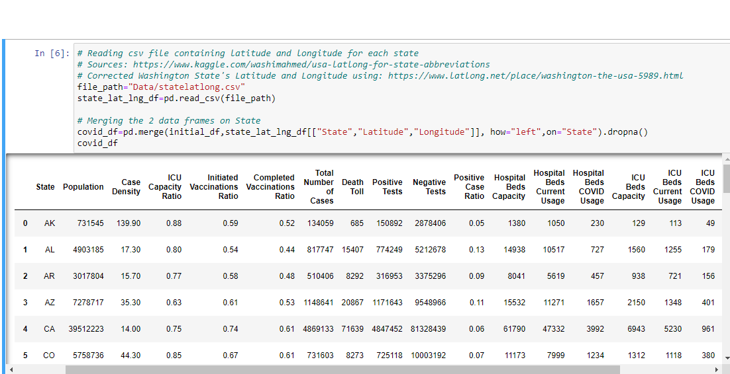
Screenshot of our Data Frame

Slide 5
Questions this analysis answers
What US states were the most affected by the COVID 19 pandemic and what was their answer to combat the pandemic?
Are the states with larger population the most impacted by COVID 19?
How are the medical services affected by COVID19?
Is the Vaccination the right answer to this pandemic?

Slide 6
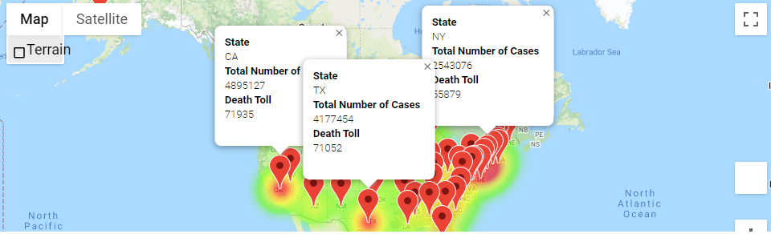
Question 1: What US states were the most affected by the COVID 19 pandemic and what was their answer?

Slide 7
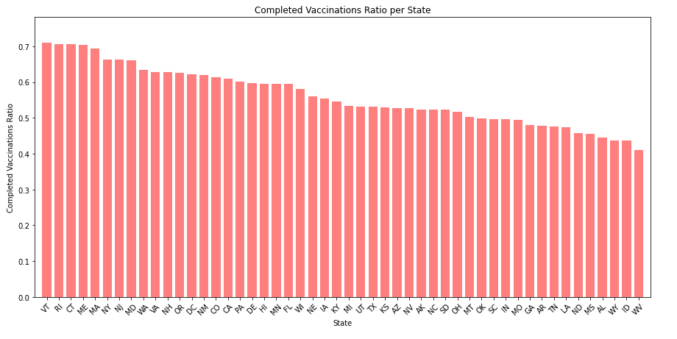
Question 1: What US states were the most affected by the COVID 19 pandemic and what was their answer?

Slide 8
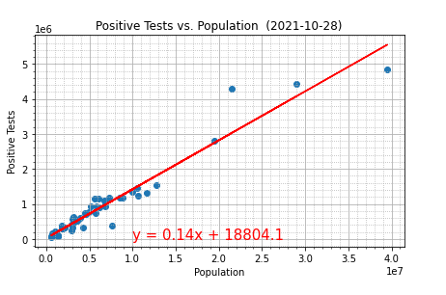
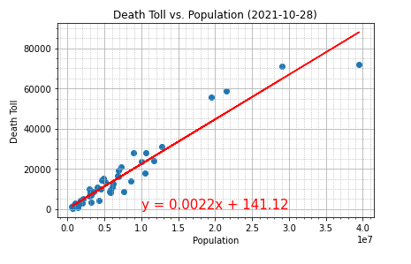
Question 2: Are the states with larger population the most impacted by COVID 19?

Slide 9
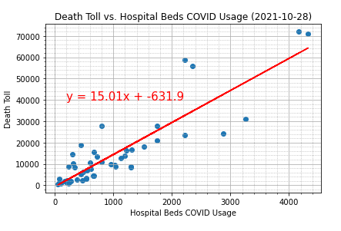
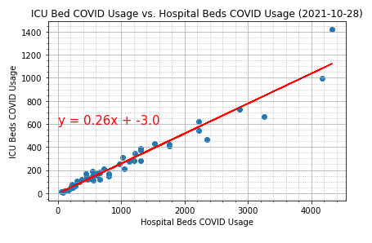
Question 3: How are the medical services affected by COVID19?

Slide 10
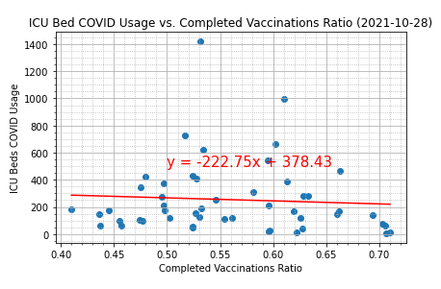
Question 4: Is the Vaccination the right answers to this pandemic?

Slide 11
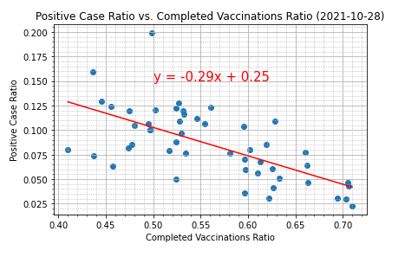
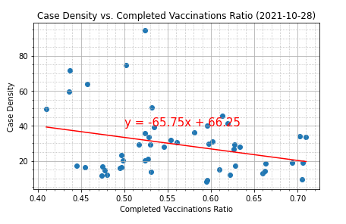
Question 4: Is the Vaccination the right answers to this pandemic?

Slide 12
Conclusions
States most affected by COVID from a volume standpoint were some of the largest states by population such as California, New York, Texas.
There is a strong relationship between overall Hospital Bed COVID Usage and their escalation to the ICU. Ultimately, cases leading to ICU admissions have a higher chance of leading to death.
Higher Vaccination ratios led to a lower Positive Case Ratio and a lower Case Density overall.

